Slide 1

SONG
POPULARITY PREDICTION
YANNIS BOADJI
EEP 596
UNIVERSITY OF WASHINGTON
AUTUMN 2024

Slide 2

INTRODUCTION
The purpose of this project is to create a regression model that would predict the popularity of a song based on parameters such as danceability, loudness, time signature, etc

Slide 3
USEFULNESS
A model such as this one can be useful in the music industry as it can help record labels with their promotional strategies

Slide 4

DATA
The dataset used for this model is a comprehensive collection of 15,150 classic hits from 3,083 artists, spanning a century of music history from 1923 to 2023. This diverse dataset is divided into 19 distinct genres, showcasing the evolution of popular music across different eras and styles. Each track in the dataset is enriched with Spotify audio features, offering detailed insights into the acoustic properties, rhythm, tempo, and other musical characteristics

Slide 5
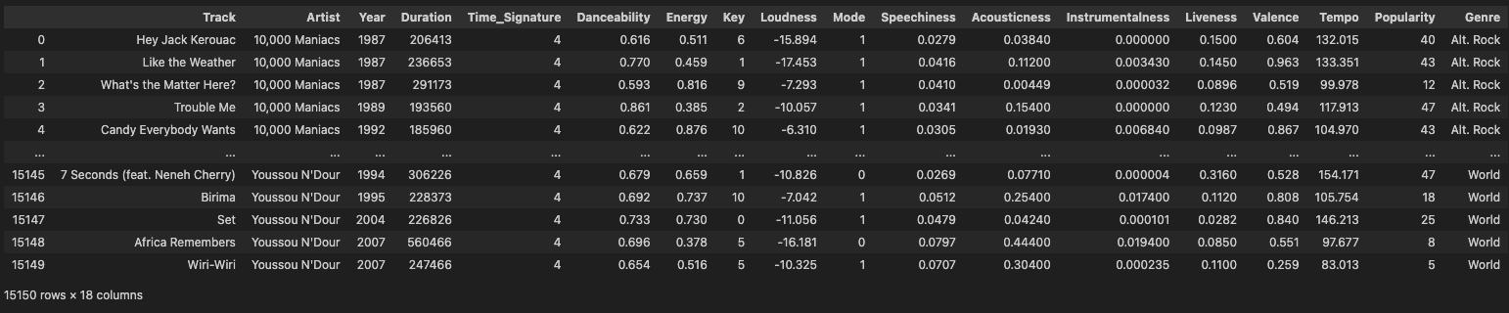

Slide 6
METHOD
Neural Network Model: Multi Layer Perceptron (with and without batching), Linear Regression
Loss Function: MSE

Slide 7
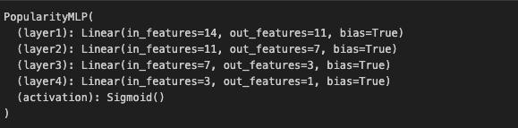
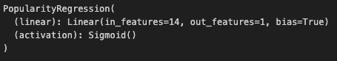
ARCHITECTURE

Slide 8
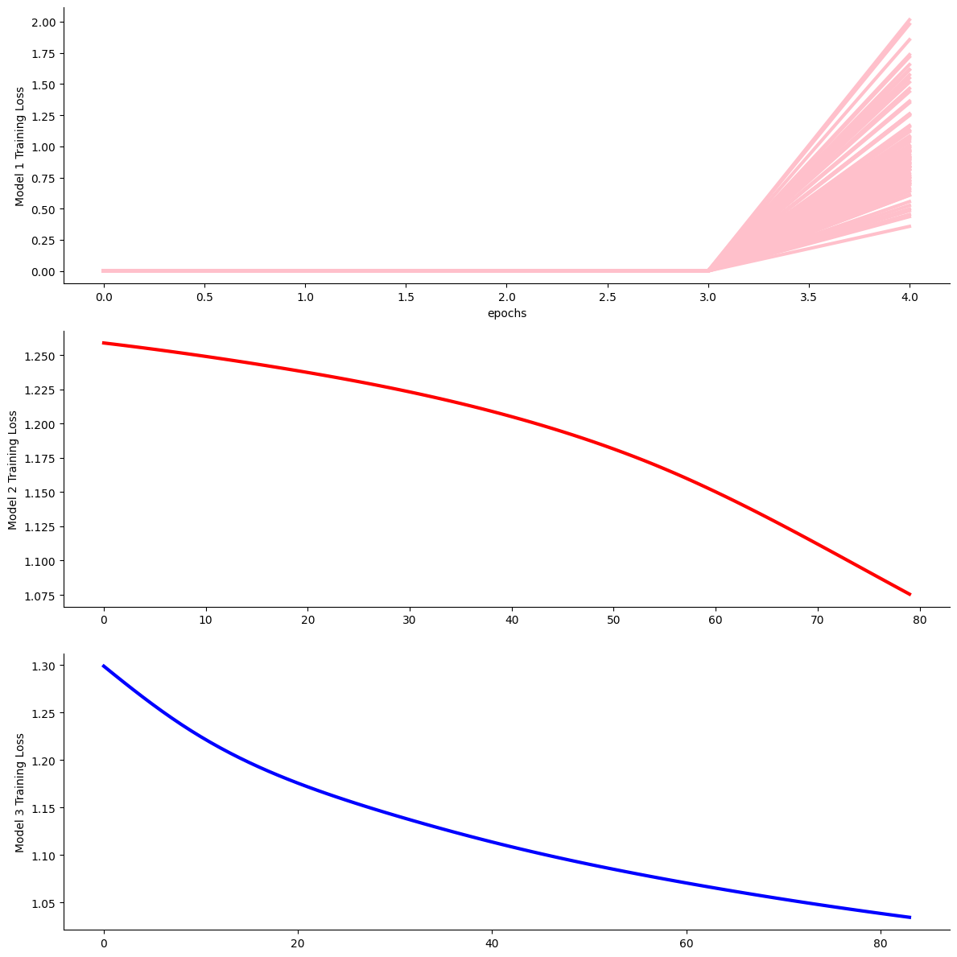
RESULTS

Slide 9
RESULTS
Model 1 MSE Error: 1.2474504
Model 2 MSE Error: 1.2641371
Model 3 MSE Error: 1.086927
The third model, which is a simple Linear Regression, had the lowest MSE error, therefore did better than the MLPs.

Slide 10
RESULTS
Nonetheless, the results did not satisfy the goal since the testing accuracies were significantly low and the predictions were far from the ground truth

Slide 11
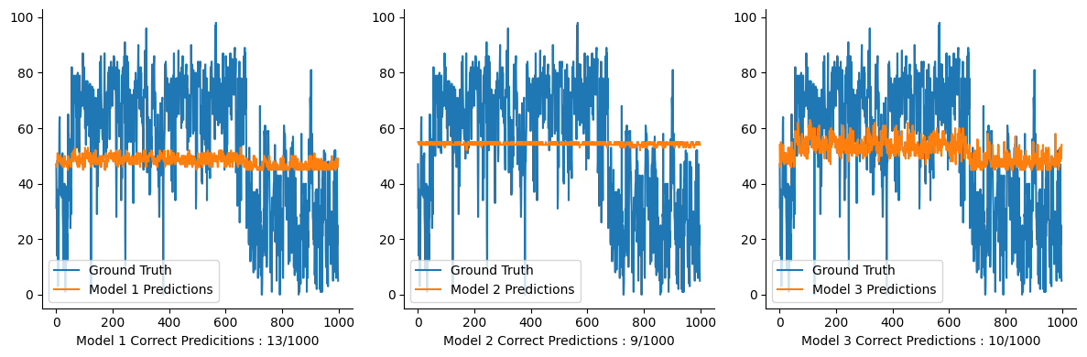
RESULTS

Slide 12
NEXT STEPS
Use a different architecture
Train a time-series model that includes the year
Build an additional model that takes an audio file as input

Slide 13


THANK YOU!!!

